Slide 1
Predicting Case Status of H1-B Petitions
Team Members:
V. Vineela 012445186
Suhani Vaishnav 012489191
Keerthi Veerabhadraiah 012466116
Canvas group Id : 12

Slide 2
INTRODUCTION
Objective : To implement various data mining techniques, to understand how the petitions received for H1B visa category are analyzed and predict the status of application
Dataset : Obtained from the Office of Foreign Labor Certification (OFLC) website : Disclosure Data

Slide 3
SYSTEM DESIGN & IMPLEMENTATION
Data Ingestion
Data Exploration
Preprocessing
Test-Train Split
Dimensionality Reduction
Training the model
Classification report
Testing the model
PCA
SVD
Random Projection
LLE
Fisher’s LDA
Variance threshold
Select K-best
Classification Algorithms
KNN | SGD
Decision trees | MLP
Extra trees | Random Forest
Bagging | Adaboost
Gradient boost

Slide 4
DATASET DESCRIPTION
1.9 million rows & 53 columns
Office of Foreign Labor Certification
Yearwise (.xlsx) format : 2015-2018
Application Case details
Case Number
Employer details
Name
Agent-attorney details
Name of the attorney
City and State
Applicant's employment details
Submission date, Decision date
Case Status
Address ( City, Postal code, Sate, Country)
Employment Start and end date
Job title
SOC name and code
Wage details
Worksite location
Full time position

Slide 5
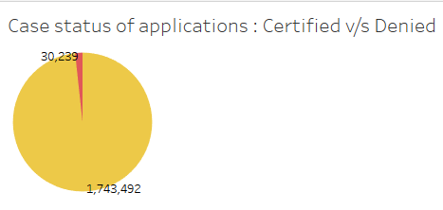
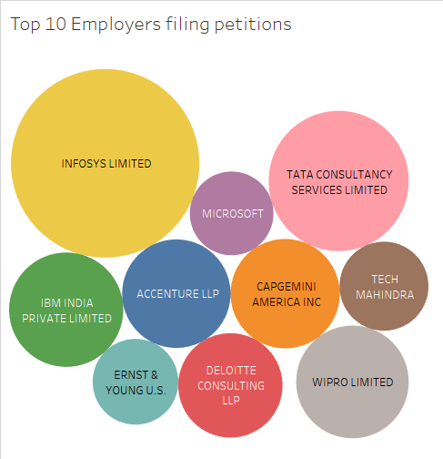
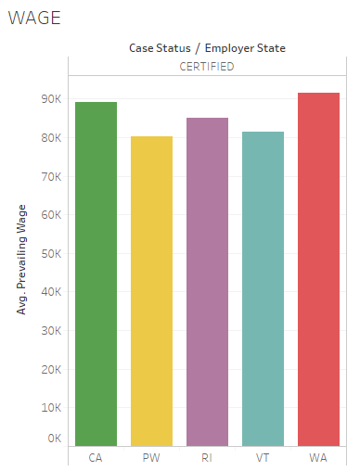
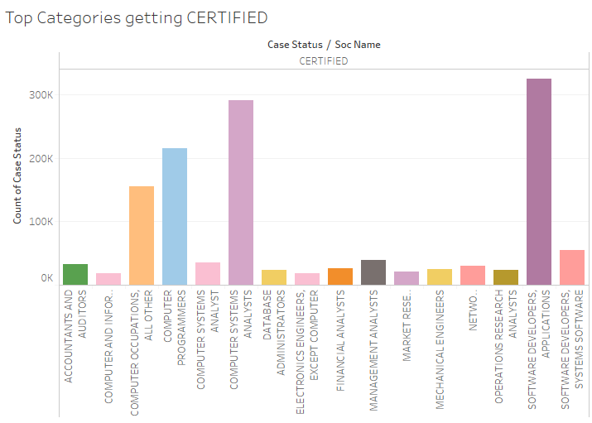

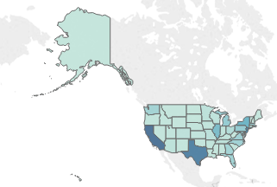

Dataset Statistics

Slide 6
Pre-processing
Dealing with Missing Values
AGENT_REPRESENTING_EMPLOYER : filled value based on ATTORNEY_NAME
EMPLOYER_COUNTRY : filled based on EMPLOYER_STATE
Feature Extraction
Standardizing the PREVAILING_WAGE and WAGE based on the UNIT_OF_PAY
Application count for each EMPLOYER_NAME
Acceptance rate for each EMPLOYER_NAME
Computing DURATION of employment
Dealing with other categorical attributes : creating dummies
Dealing with binary attributes : label binarizer

Slide 7
Methodology
Test (20%)
Train (80%)
Implementation of classifiers
Cross-fold validation for k=5,10 for top 3 performing classifiers
Tuning: GridSearchCV
Plotting ROC curve for classifier with highest accuracy

Slide 8
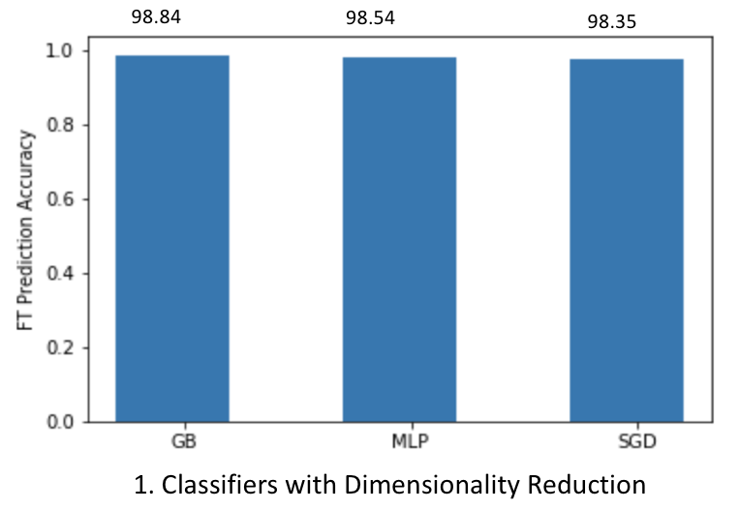
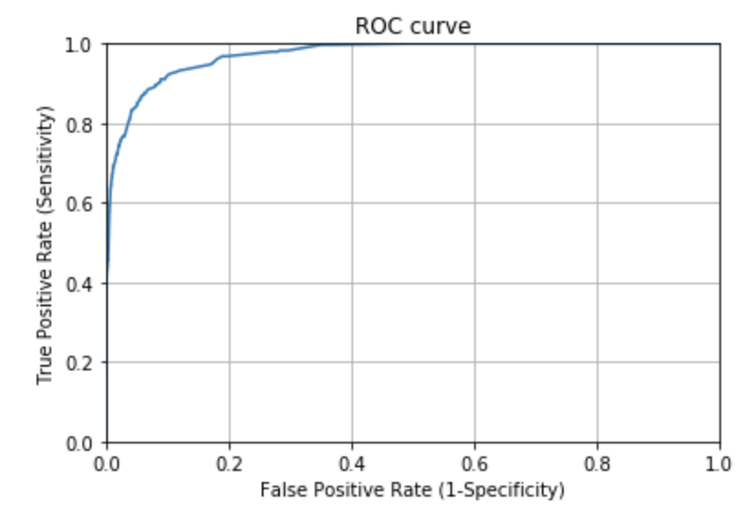
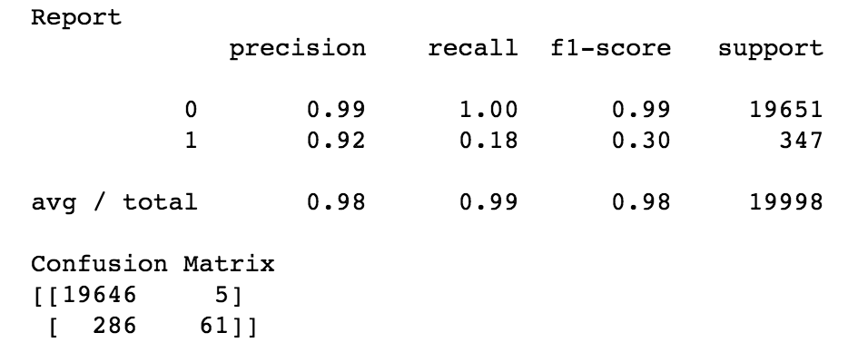
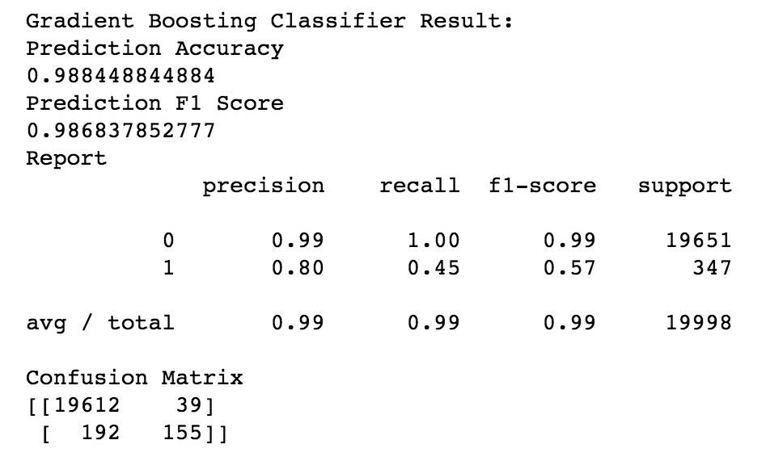
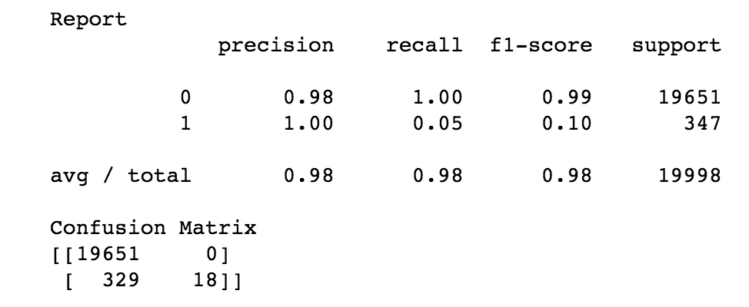
Results Classifiers with Dimensionality Reduction
MLP Classifier
Gradient Boost
SGD

Slide 9
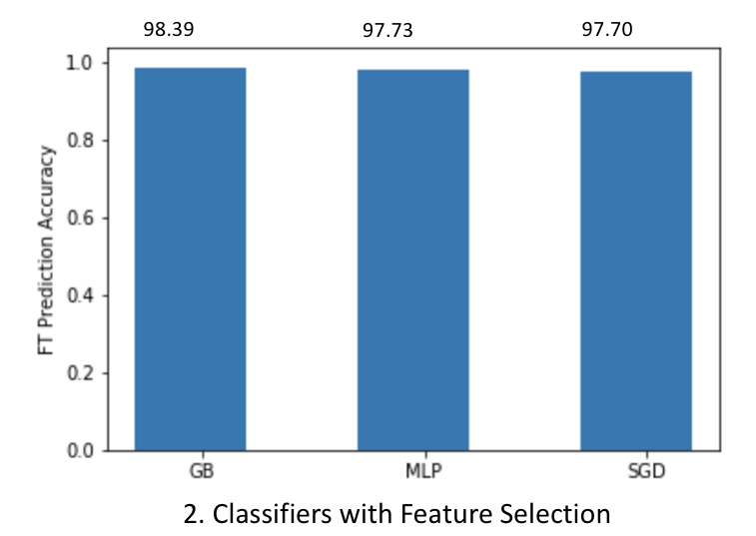
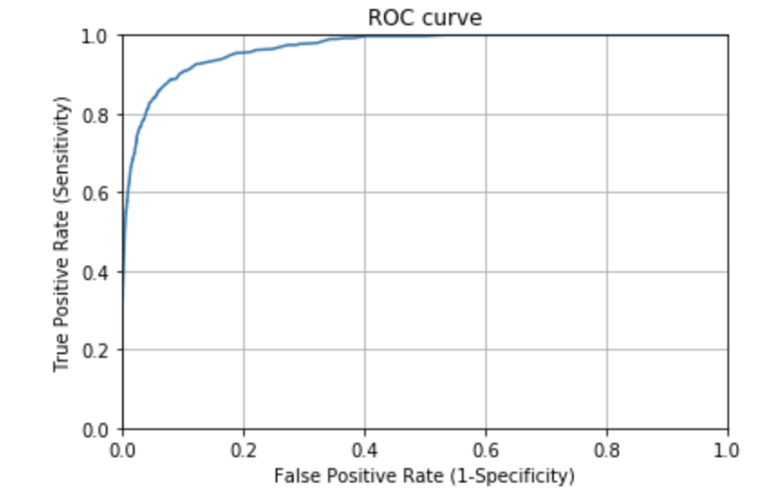
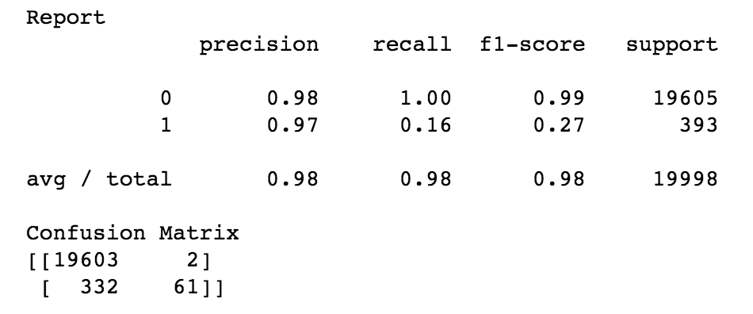
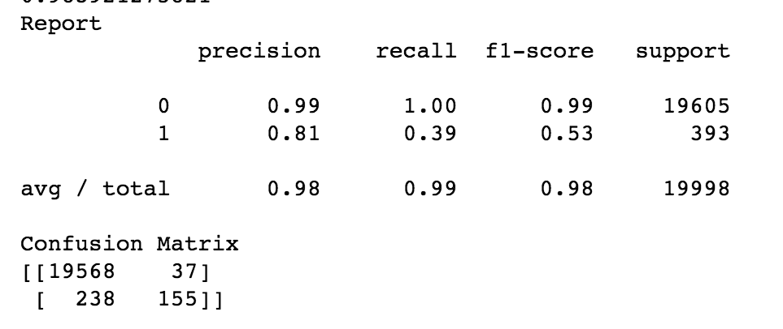
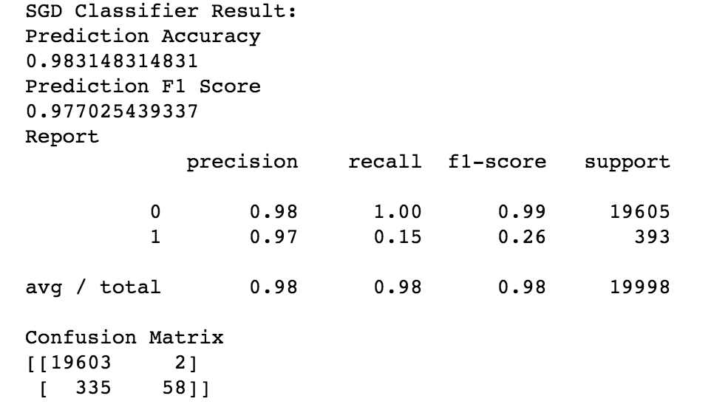
Results Classifier with Feature Selection
MLP Classifier
Gradient Boost
SGD

Slide 10
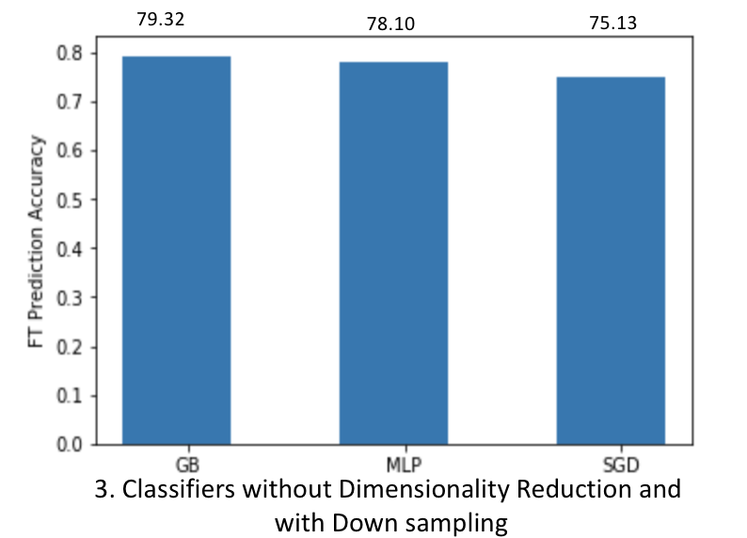
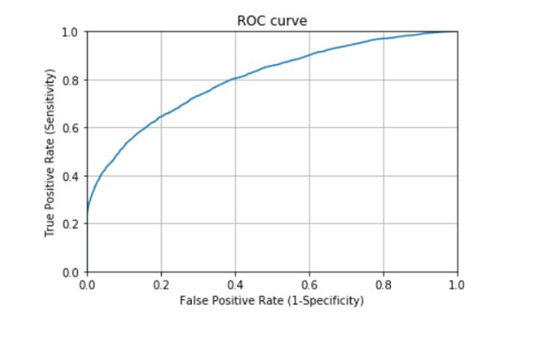
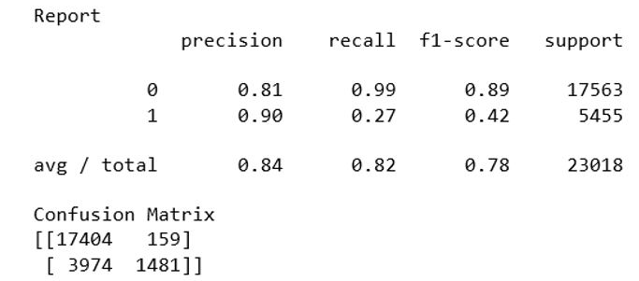
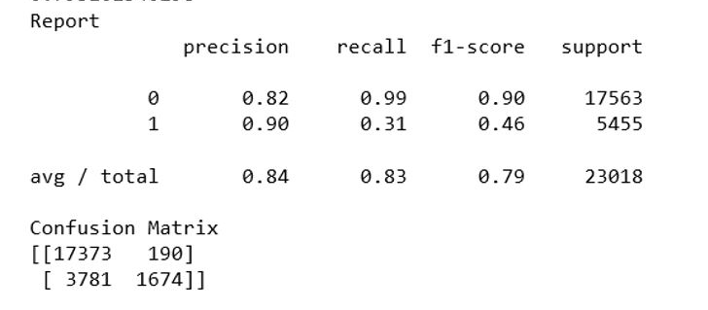
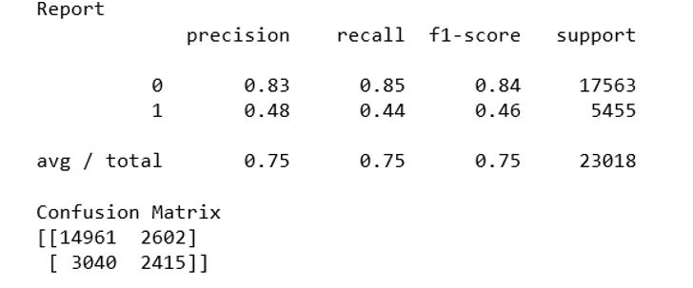
Results No dimensionality reduction & Down-sampling
MLP Classifier
Gradient Boost
SGD

Slide 11
Difficulties faced
Dealing with large number of categorical attributes
EMPLOYER_NAME : ~64k unique values
Creating dummies -> Curse of dimensionality
Trial & error : Sparse conversion, feature hashing, DictVectorizer
Application count & Acceptance rate : new columns created
Use of HPC – dealing with bash scripts, timeout & memory error
Prolonged computation time for few algorithms

Slide 12
Conclusion
Top 5 features influencing the prediction
Gradient Boost classifier with Dimensionality Reduction (PCA) results in highest F1-score of 98.84%.
Accepted Rate
Increment from Prevailing Wage
Duration
Increment
Application count

